Slide 1
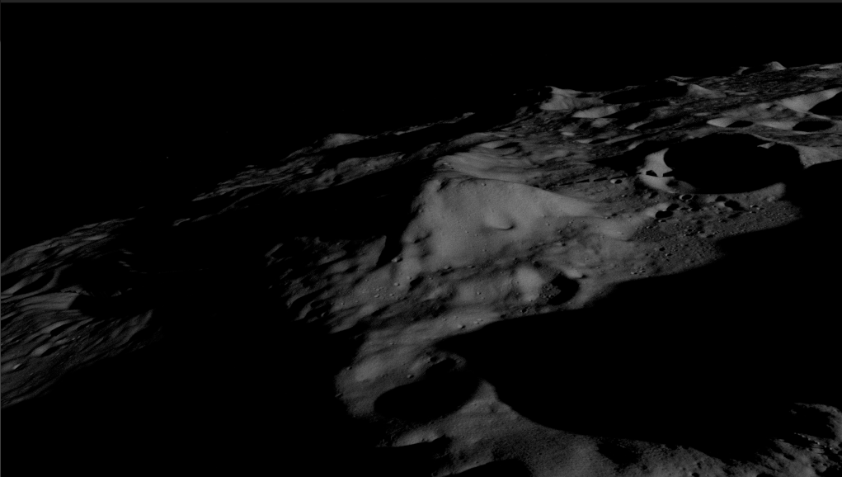
Illumination Analysis Tools for VSAT
Astrobotic Technology, Inc.
Lunar Surface Innovation Consortium
January 17, 2024

Slide 2
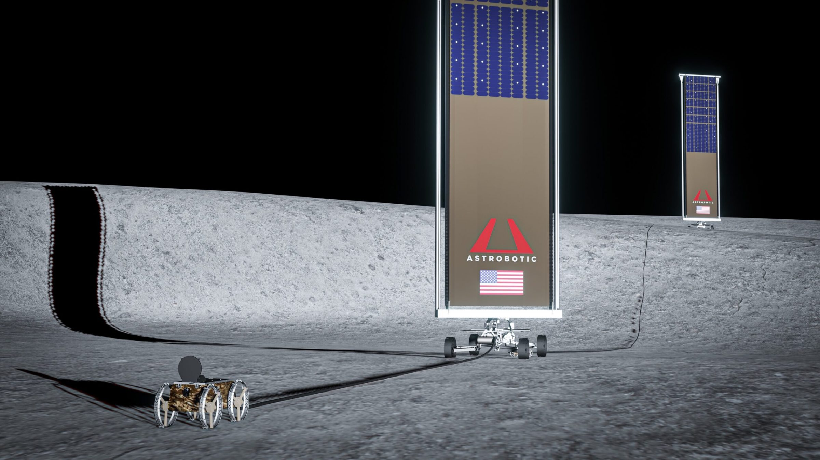
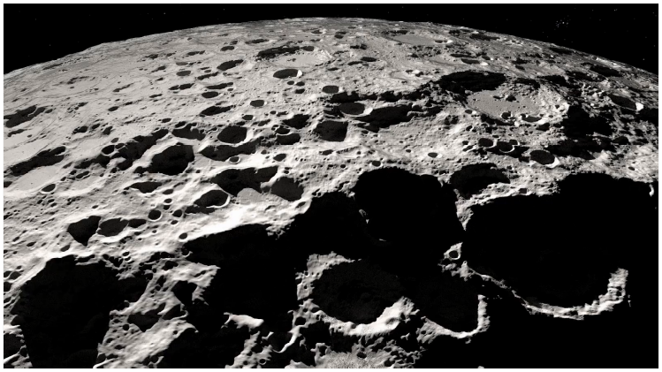
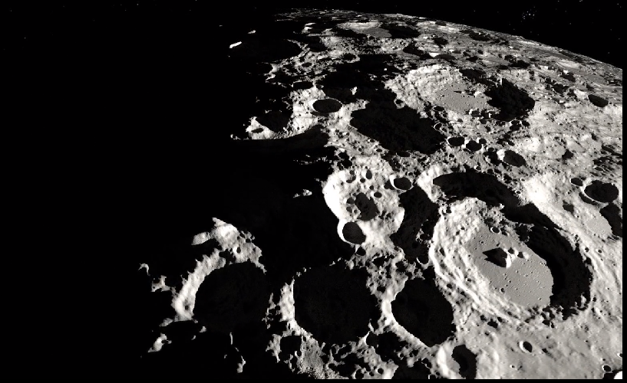
VSAT and Illumination at Moon's south pole - Background
Need: Reliable and sustainable power source to support various robotics and crewed missions
Solution: NASA plans to deploy solar arrays at Moon's south pole
Challenge: Lunar polar regions experience unusual illumination conditions and portions of craters are deep enough to create permanently shadowed regions
Solution (/Requirement): Solar arrays must be vertically oriented and deployed at an elevated position relative to ground level to avoid obstruction by topography and capture sunlight at lower incident angles
Astrobotic's LunaGrid system illustration
Illustration of illumination variation at Moon's south pole

Slide 3
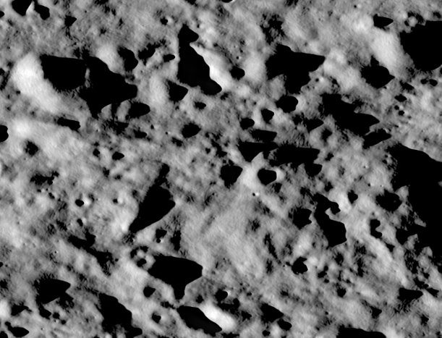
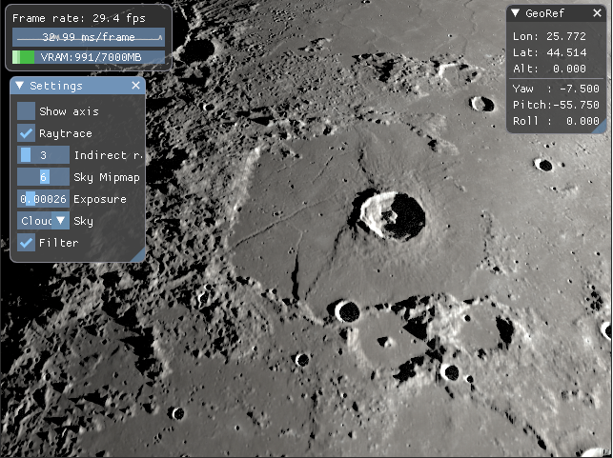
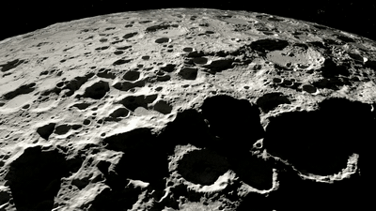
ASTROBOTIC Tool #1: Lunaray
What it is: Physically-based renderer for generation of accurate illumination conditions onto terrain and spacecraft models
SPICE kernel-based ephemeris setting
Lighting and ephemerides validated against JPL and NASA JSC scene generators, as well as LRO NAC imagery
What it does: Supports map generation, manual scene generation, and interactive modes
How it supports requirement: Supports VSAT through illumination verification and validation, and site selection
Scene and map gen. mode
Interactive mode
Illustration of South pole illumination variation

Slide 4
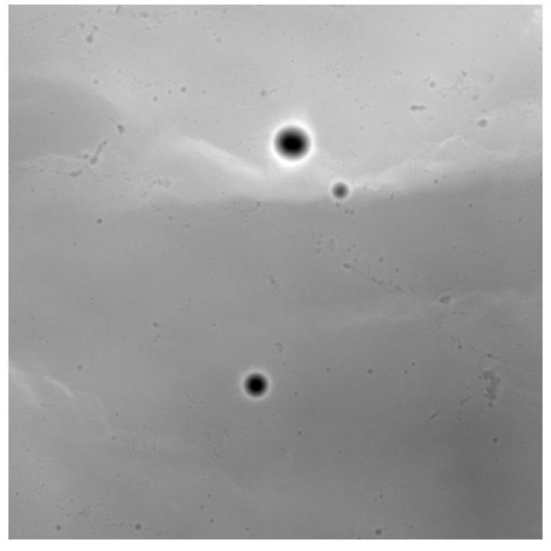
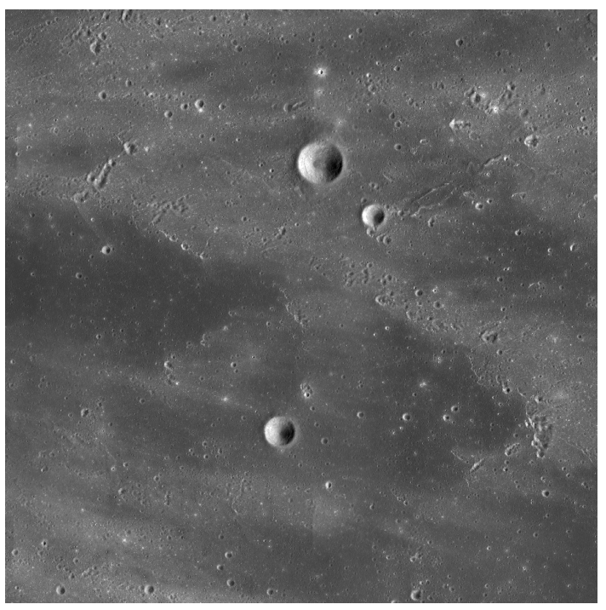
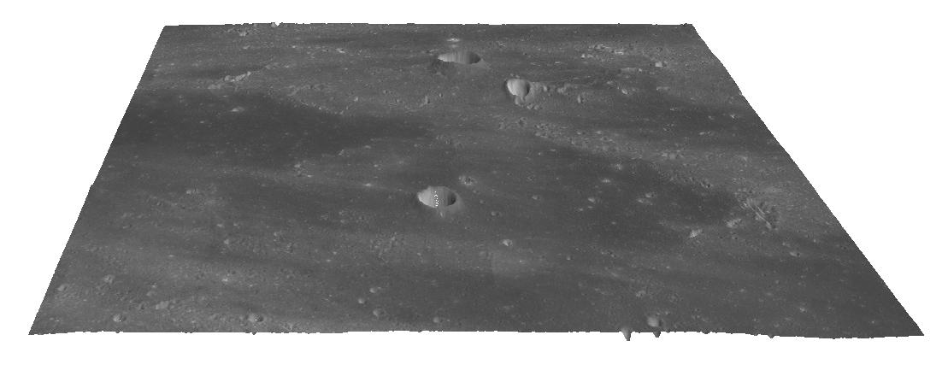
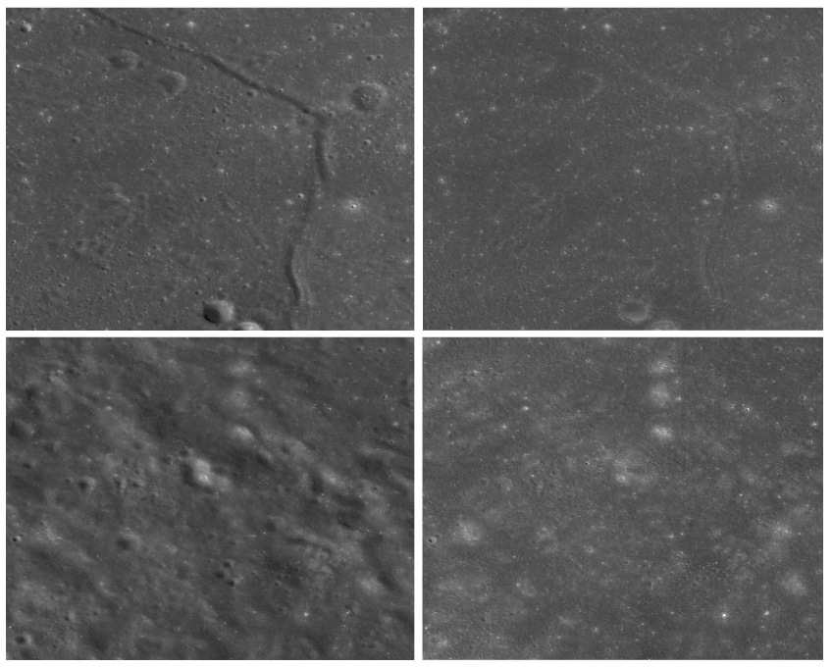
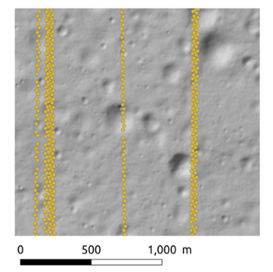
Astrobotic Tool #2: DEMkit
What it is: Set of applications for lunar terrain model generation, analyses, and verification
What it does:
Tools to select and download NAC images and LOLA data
Generates DEMs with state-of-the-art photogrammetric methods from raw orbital datasets
Robust V&V to account for geodetic alignment, distortions, and elevation inaccuracy
Shadow removal capability to recreate images
Landing site analysis and illumination evaluation
How it supports requirements: Allows user to evaluate illumination conditions at selected positions
Uses ray tracing technique similar to that of LunaRay
Incorporates terrain data of multiple resolutions to capture long shadows
Creates illumination results for given duration of time
Elevation data
Appearance data
3D Scene
Comparison of LOLA data vs. DEM
Shadow removal capability

Slide 5
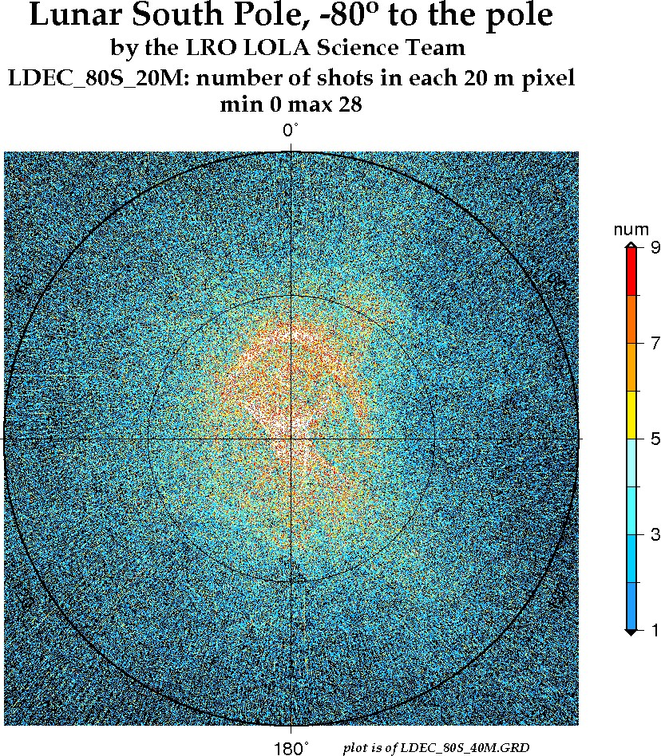
Data used
LOLA DEMs used to capture long shadows at far side
The sparsity of LOLA points increases as we move further away from south pole
Local topographical changes are not captured in LOLA DEM
LOLA data along with LRO NAC images used to create the high-resolution DEM
Capability to create up to 1 meter per pixel DEMs based on NAC image resolution availability

Slide 6
Thank you
ebrahim.mohammadi@astrobotic.com
https://www.astrobotic.com

